Slide 1
Introduction to
Network and Information Security
Business Data Communications and Networking 9th Edition Jerry Fitzgerald and Alan Dennis John Wiley & Sons, Inc

Slide 2
Introduction
Security has always been a major business concern
Physical assets are protected with locks, barriers, guards.
Information assets are protected with passwords, coding, certificates, encryption.
Computers and Internet have redefined the nature of information security
Laws and enforcement in cyber crime
Slow to catch-up
Breaking into a computer is now a federal crime in the U.S.
New laws against cyberborder crimes, yet difficult to enforce, sentences are typically very light

Slide 3
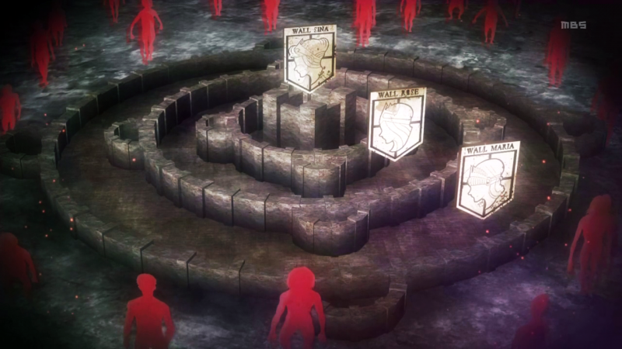
Shingeki no Kyojin, Attack on Titan Wall

Slide 4
Kingdom walls
Wall Maria
Height 50 m, radius of 480km.
Between Wall Maria and Wall Rose is 100km.
100 year period of peace
Wall Rose
radius of 380 km
Between Wall Rose and Wall Sina is 130 km.
Wall Sina
radius of 250 km
The safest place within the Kingdom
The King resides.

Slide 5
Size of Typical Titan
3-6 m
7 m
15 m

Slide 6

Colossal Titan >50 m

Slide 7
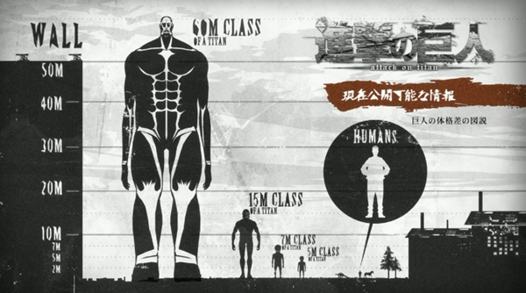
Titan Class

Slide 8
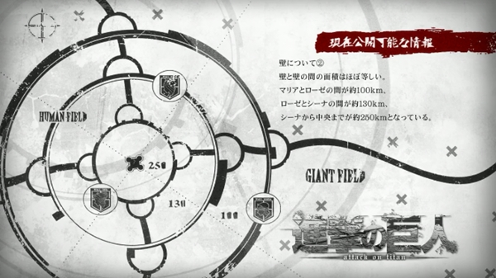
Wall

Slide 9






Slide 10
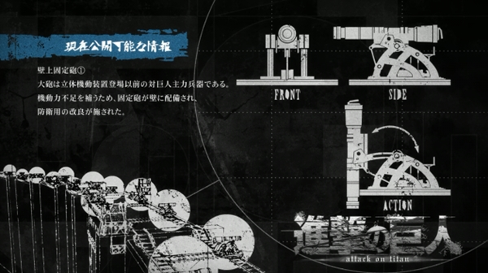
Weapon

Slide 11
Primary Goals in Providing Security: “CIA”
Confidentiality
Protection of data from unauthorized disclosure of customers and proprietary data
Integrity
Assurance that data have not been altered or destroyed
Availability
Providing continuous operations of hardware and software so that parties involved can be assured of uninterrupted service

Slide 12
Computer Security Incidents
Computer security increasingly important
Incidents are escalating at increasing rate
Computer Emergency Response Team (CERT) was formed at Carnegie Mellon University with US DoD support
www.cert.org

Slide 13
Types of Security Threats
Business continuity planning related threats
Disruptions
Loss or reduction in network service
Could be minor or temporary (a circuit failure)
Destructions of data
Viruses destroying files, crash of hard disk
Disasters (Natural or manmade disasters )
May destroy host computers or sections of network
Intrusion
Hackers gaining access to data files and resources
Most unauthorized access incidents involve employees
Results: Industrial spying; fraud by changing data, etc.

Slide 14
Network Controls
Mechanisms that reduce or eliminate the threats to network security
Types of controls:
Preventative controls
Mitigate or stop a person from acting or an event from occurring (e.g., locks, passwords, backup circuits)
Act as a deterrent by discouraging or restraining
Detective controls
Reveal or discover unwanted events (e.g., auditing)
Documenting events for potential evidence
Corrective controls
Remedy an unwanted event or a trespass (e.g., reinitiating a network circuit)

Slide 15
Securing the Network
Securing the network requires personnel designated to be accountable for controls:
Develop network controls
Ensure that controls are operating effectively
Update or replace controls when necessary
Need to be reviewed periodically for usefulness, verification and testing:
Ensure that the control is still present (verification)
Determine if the control is working as specified (testing)
Is the control still working as it was specified?
Are there procedures for temporary overrides on control?

Slide 16
Security Threats
Identify threats
Any potentially adverse occurrence that can
Harm or interrupt the systems using the network, or
Cause a monetary loss to an organization
Rank threats according to
Their probability of occurrence
Likely cost if the threat occurs
Take the nature of business into account
Example: Internet banking vs. a restaurant
Bank’s web site: has a higher probability of attack and much bigger loss if happens
Restaurant web site: much less likely and small loss

Slide 17
Preventing Computer Viruses
Viruses spreads when infected files are accessed
Macro viruses attach themselves to other programs (documents) and spread when the programs are executed (the files are opened)
Worms
Special type of virus that spread itself without human intervention (sends copies of itself from computer to computer)
Anti-virus software packages check disks and files to ensure that they are virus-free
Incoming e-mail messages are most common source of viruses
Check attachments to e-mails, use filtering programs to ‘clean’ incoming e-mail

Slide 18
Intrusion Prevention
Types of intruders
Casual intruders
With Limited knowledge (“trying doorknobs”)
Script kiddies: Novice attackers using hacking tools
Security experts (hackers)
Motivation: the thrill of the hunt; show off
Crackers: hackers who cause damage
Professional hackers (espionage, fraud, etc)
Breaking into computers for specific purposes
Organization employees
With legitimate access to the network
Gain access to information not authorized to use

Slide 19
Preventing Intrusion
Requires a proactive approach that includes routinely testing the security systems
Best rule for high security
Do not keep extremely sensitive data online
Store them in computers isolated from the network
Security Policy
Critical to controlling risk due to access
Should define clearly
Important assets to be safeguarded and Controls needed
What employees should do
Plan for routinely training employees and testing security controls in place

Slide 20
Securing Network Perimeter
Basic access points into a network
LANs inside the organization
Dial-up access through a modem
Internet (most attacks come in this way)
Basic elements in preventing access
Physical Security
Dial-in security
Firewalls
Network Address Translation (NAT) Proxy servers

Slide 21
Physical Security
Means preventing outsiders from gaining access into offices, server rooms, equipment
Secure both main and remote facilities
Implement proper access controls to areas where network equipment is located
Only authorized personnel to access
Each network component to have its own level of physical security
Have locks on power switches and passwords to disable keyboard and screens
Be careful about distributed backup and servers
Good for continuity, but bad for unauthorized access
More equipment and locations to secure

Slide 22
Securing Network Devices
Should be secured in locked wiring closets
More vulnerable: LAN devices (controllers, hubs, bridges, routers, etc.,)
A sniffer (LAN listening device) can be easily hooked up to these devices
Use secure hubs: requires special code before a new computers are connected

Slide 23
Authenticating Users
Done to ensure that only the authorized users are permitted into network
and into the specific resources inside the network
Basis of user authentication
User profile
User accounts based on something you have, know or are
Smart card, time based token is something you have
Password is something you know
Biometric is something you are
Network authentication

